Slide 1
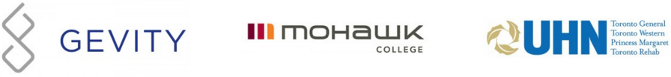
Authoring Profiles (Abbreviated for FHIR North)
Lloyd McKenzie
Apr. 27, 2016

Slide 2
This presentation
Can be downloaded here:
http://gforge.hl7.org/svn/fhir/trunk/presentations/2016-04%20FHIR%20North/Authoring Profiles%20-%20short.pptx
Use “anonymous” and email address to logon
Is licensed for use under the Creative Commons, specifically:
Creative Commons Attribution 3.0 Unported License
(Do with it as you wish, so long as you give credit)
So thanks to Ewout Kramer who produced most of these slides!

Slide 3
The need for profiling
Many different contexts in healthcare, but a single set of Resources
FHIR provides a “platform specification”
Requires further adaptation to context of use

Slide 4
The need for Profiles
Many different contexts in healthcare, but a single set of Resources
Need to be able to describe restrictions based on use and context
Allow for these usage statements to:
Authored in a structured manner
Published in a repository
Used as the basis for validation, code, report and UI generation.

Slide 5
The need for Profiles
Profiles can serve the same purpose as:
CDA templates & implementation guides
HL7 v2 “static” profiles
CIMI implementation guides
OpenEHR Archetypes & templates
Profiles aren’t mandatory for interoperability, but they improve the degree of it.
Profiles never change meaning of an instance

Slide 6
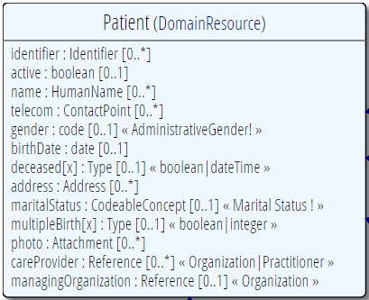
Profiling a resource
Demand that the identifier uses your national patient identifier
Limit names to just 1 (instead of 0..*)
Limit maritalStatus to another set of codes that extends the one from HL7 international
Add an extension to support “RaceCode”
Note: hardly any mandatory elements in the core spec!

Slide 7
Structured & published
A Profile is just a “normal” Resource
Any FHIR server could serve Profiles (just like Patients, Observations, etc…)
So, any FHIR server is a profile repository!
You can send a resource and the profile it conforms to in the same bundle
A resource is simply referred to by its URI:
e.g. https://hl7.org/fhir/Profile/iso-21090

Slide 8
Using profiles
When communicating a resource, you can indicate the profiles it conforms to.
A server might explicitly state it only accepts resources conforming to a certain profile (and verify!)
You can ask a FHIR server to validate a resource against a given profile
Notes:
Be cautious about relying on declared profiles – not all systems will declare, not all declarations will be right.

Slide 9

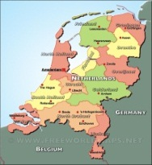

Who publishes?
http://www.hl7.org/fhir/Profile/iso-21090
http://www.hl7.nl/fhir/Profile/patient-nl
http://www.health4all.org/fhir/Profile/
Notes:
“Drive-by” or “bottom-up” operability: “Communicate first, standardize later”
First, business partners. Then, collaborations, communities. Maybe, finally, nation-wide
It’s a natural process that people will want to make it work first, then only coordinate what they really need to, and then realize they can broaden their approach to a community.
“Support”, of course top-down should still be possible! Maybe even a combi in the long-term

Slide 10
What’s in a profile?
Conformance
Metadata
Identifier
Name, Version
Publisher
Description, Code
Status
Date (of publication)
Search Parameter
Resource and Datatype Constraints
Resource (via Tag)
Extension
Extension in Resource instance
ValueSet
ValueSet

Slide 11
Scale / design
Make a profile with just extensions
Make a profile with just 1 resource + extensions on that resource
Make a profile that includes all constraints on resources and data types in a message or document
Make a profile with all (say national) resources + extensions.

Slide 12
Conformance Resources
Terminology
Code System
Value Set
Naming System
Content
Structure Definition
Data Element
Behavior
Operation Definition
Search Parameter
Conformance
Misc.
Implementation Guide
Test Script
Structure Map
Concept Map

Slide 13
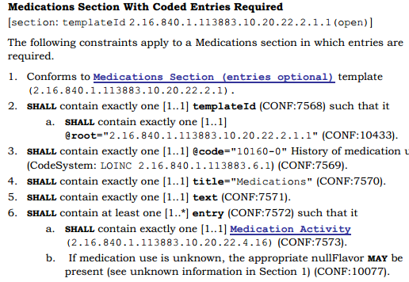
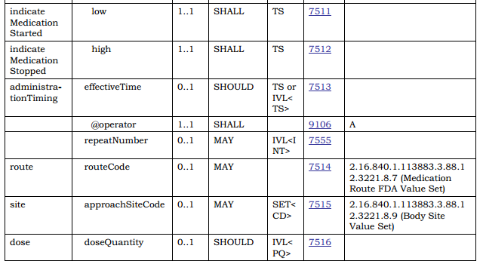
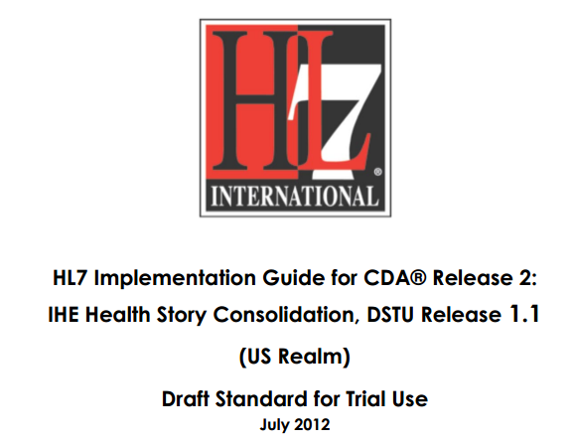
In v3 CDA…”text-based”

Slide 14
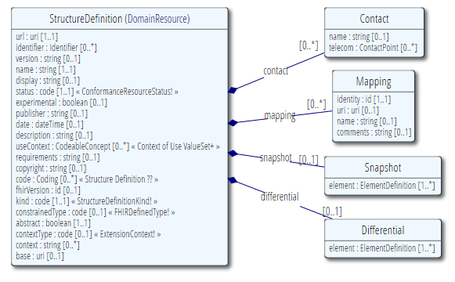
Conformance Resources are Resources
Fully computable (with Narrative ☺)
Create/Update/Query/Publish/Subscribe
Include in documents & messages
Add extensions

Slide 15
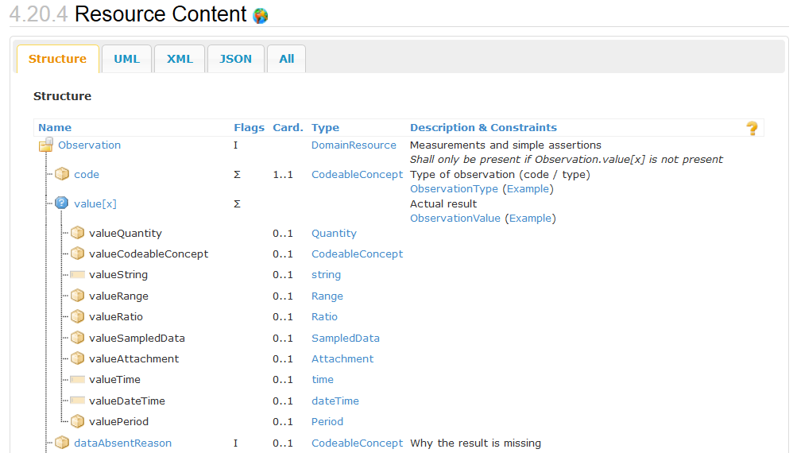
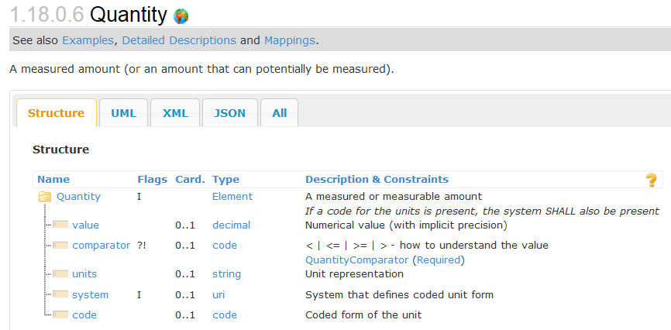
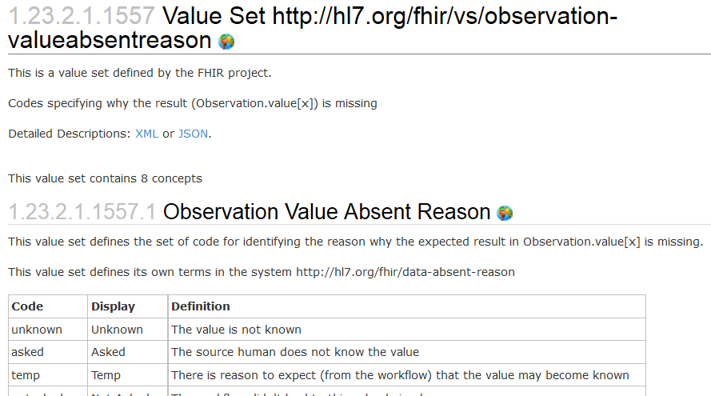
Used in the core spec
For implementer convenience, the specification itself publishes its base definitions using these same resources!

Slide 16
Extensions
Accommodate those elements not supported by 80% of systems
Note - You’re not extending a resource per se, but you specify where an extension may occur:
A specific element within a resource (even root)
A specific element within a data type
All elements referencing a data type
All elements mapping to a specific mapping target
An extension

Slide 17
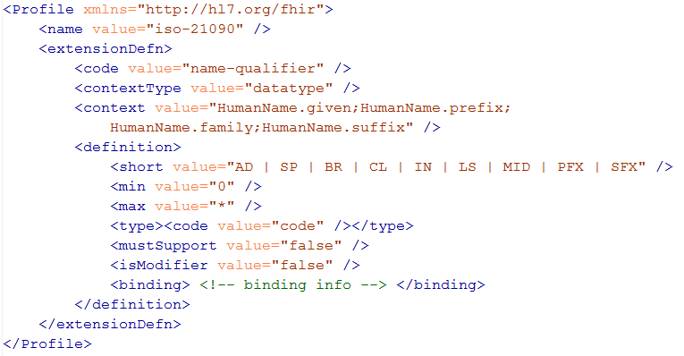
Extension definition
Note: multiple
contexts!

Slide 18
Must support?
Authors: SHALL be capable of providing a value for the element and resource
Consumers: SHALL be capable of extracting and doing something useful with the data element.
"Something useful" is context dependent. The Profile SHALL describe what it means for applications to “support” the element
Notes:
* Note: the spec *never* sets this to true, since it’s context dependent.

Slide 19
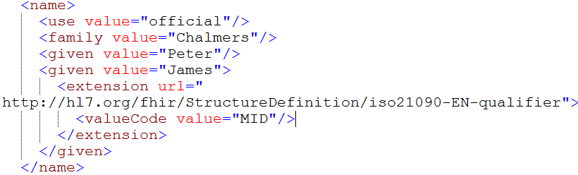
Extending a name
Key = location of formal definition
Value = value according to definition
Notes:
Extensions can show up anywhere – inside a Boolean, string, human assignment

Slide 20
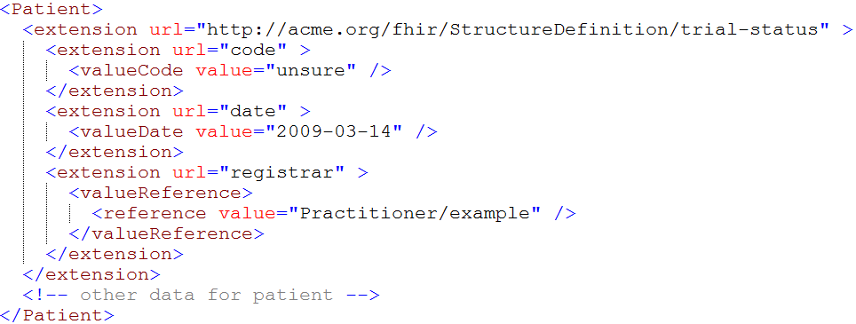
Extending an extension?

Slide 21
Constraints
Profiles contain “Structures”: a set of constraints on (nested) elements of a Resource or Datatype
You give each structure a “name”, so you can refer to it (e.g. from a Profile Tag)
You can make structures “internal”: local to the package for purpose of reuse
Datatype constraints are always done for reuse of constraints

Slide 22
Constraining cardinality
Limit cardinality to 1..2
(e.g. to at maximum your organizations’ identifier + the national one)
1..2
1..1
0..0
Limit names to just 1 (instead of 0..*)
Forbid any telecom elements
Note: something that’s mandatory in the core definition cannot be made optional in a profile

Slide 23
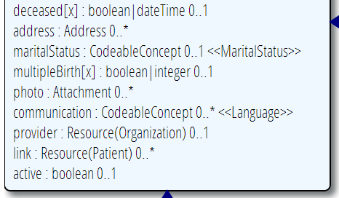
Limit value domains
If deceased is given, it must be a dateTime, not a boolean
AddressNL
Use a profiled datatype (from this or other profile)
OrganizationNL
=“true”
Only allow reference to a profiled resource
Only allow “active” Patients

Slide 24
Contextualize narrative
Override the base spec’s descriptions by adding context specific narrative:
short : string 1..1
formal : string 1..1
comments : string 0..1
requirements : string 0..1
synonym : string 0..*
example[x] : 0..1 (example value!)
mappings : 0..* (more specific mappings)

Slide 25
Profiling bindings
Depending on “core” spec, you can:
“fixed”: not specify a different binding
“incomplete”: specify a different binding if needed
“example”: very likely specify a different binding
Change the bindings as specified in core:
Define a new ValueSet
Allow additional codes, Restrict to a subset
Specify whether implementers of your profile can deviate from your valueset.

Slide 26
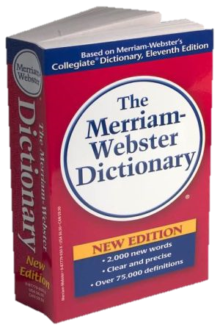
CodeSystem vs. ValueSet
“Dante’s deadly sins”
Pride
Envy
Wrath
Sloth
Avarice
Gluttony
Lust
Takes concepts from…
Definition of terms
An enumeration of terms
“CodeSystem”
“ValueSet”
Example: SNOMED-CT
Example: “Childhood diseases”

Slide 27

“Special” cases
No need to write them all down!
Takes concepts from…
“All words under B”
“All words in the
Merriam-Webster dictionary”
“Words for ‘nerd’”
Bookworm
Geek
Grind
Weenie
Wonk
Dink (slang)
Dork (slang)
Takes concepts from…
Takes concepts from…
Can take concepts from multiple codingsystems

Slide 28
Conformance levels
Fixed: You must use this value set if you send the element.
If it’s a CodeableConcept, you can sent translations too
Extensible: You must use a code from this value set if one applies
Preferred: Recommend using this code system, but ok if you don’t
Example: No recommendation, may be incomplete

Slide 29
Add formal constraints
Invariants, co-occurrence
Uses free text (human) + xpath (executable)
Moving to FluentPath
Constraints should be declared on lowest element in the hierarchy that is common to all nodes referenced by the constraint.
Identified by (local) id, involved elements refer to that id
Specify severity (“error” or “warning”)

Slide 30
Slicing
Schematic view of Composition (aka a Document header)
Composition
type: CodeableConcept
Section
code: CodeableConcept
content: Resource(Any) 0..1
0..*
Slicing = constraining a repeating element
Base Composition has 0..* “Sections”
Section has 0..1 element with content

Slide 31
Slicing into a CCD
Composition
type = “34133-9” “Summarization of
episode note”
Section
code = 42348-3 (“Advance directives”)
Section
code =11450-4 (“Problem list”)
…
Section
code = 18776-5 (“Treatment plan”)
“Slice” the repeating sections into a fixed set of profiled sections.
“code” is fixed and is called the discriminator

Slide 32
Aggregation
Aggregation: for each ResourceReference choose 1..3:
Code | Definition
contained | Reference to a contained resource.
referenced | Reference to a resource that has to be resolved externally
..bundled | Reference points to will be found in the same bundle

Slide 33
Profile-less FHIR
You don’t need profiles to interoperate with FHIR
Resources are “discrete” enough that mechanism to populate most elements is clear
Approach
Populate/consume all elements you know, use HL7 or country-standard extensions for extras
Map to/from “recommended” terminologies as much as possible, populate CodeableConcept.text
Expose capabilities in Conformance resource
Notes:
With profile, they can interoperate ‘ok’.

Slide 34
Profile Uses
Profiles are still quite useful
Define documents and messages
Define extensions, search parameters
Set interoperability expectations in a particular context
National standards, types of care, business patterns
Clinical practice guidelines / detailed clinical models
Document system capabilities

Slide 35
Simultaneous profiles
Multiple profiles can apply to an instance at the same time
Different codings for different value sets
Include the union of all needed elements
Works best when profiles don’t constrain max occurrences

Slide 36
Declaring profiles
Instances can identify what profiles they support using tags
Considerations:
Is declaration version-specific?
Do you trust the declaration to be accurate?
Will all clients declare the profiles of interest on submissions?
What about profiles of interest defined after data is received?

Slide 37
Profiles at run-time
In addition to design-time constraints, profiles can be used at run-time
Load a profile to guide user-entry to meet a particular best practice guideline
Validate against a profile to determine whether an instance meets certain requirements (e.g. for decision-support)
Adjust data entry rules on-the-fly to reflect the constraints of a specified server

Slide 38
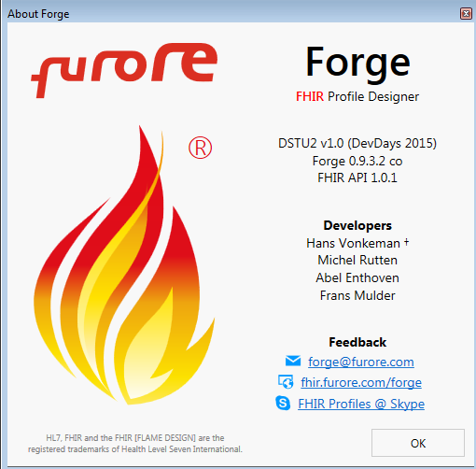
Forge
New (free) tool for editing FHIR Profiles
Released!
Demo?

Slide 39
Conformance
There’s a resource for documenting conformance to FHIR
Can be used for:
Stating how a specific system instance behaves
Defining how a software system is capable of behaving (including configuration options)
Identifying a desired set of behavior (e.g. RFP)
To declare themselves “FHIR Conformant”, a system must publish a Conformance instance

Slide 40
How to get conformance
Conformance is again, just a Resource
Any FHIR server will publish his own conformance at a special endpoint
A FHIR server may store and publish any number of additional Conformance resources, so you can refer to them
Validatable by automated testing
Notes:
Conformance registry could be used for discovery of participants in a regional exchange, means of advertising system capability, etc.
No tools yet for authoring – volunteers?

Slide 41
Conformance at run-time
In theory, a client can auto-configure itself based on a declared conformance profile
What resources can be accessed, what data elements are used, etc.
Because the location for a system’s conformance statement is fixed, all you need is the base URI

Slide 42
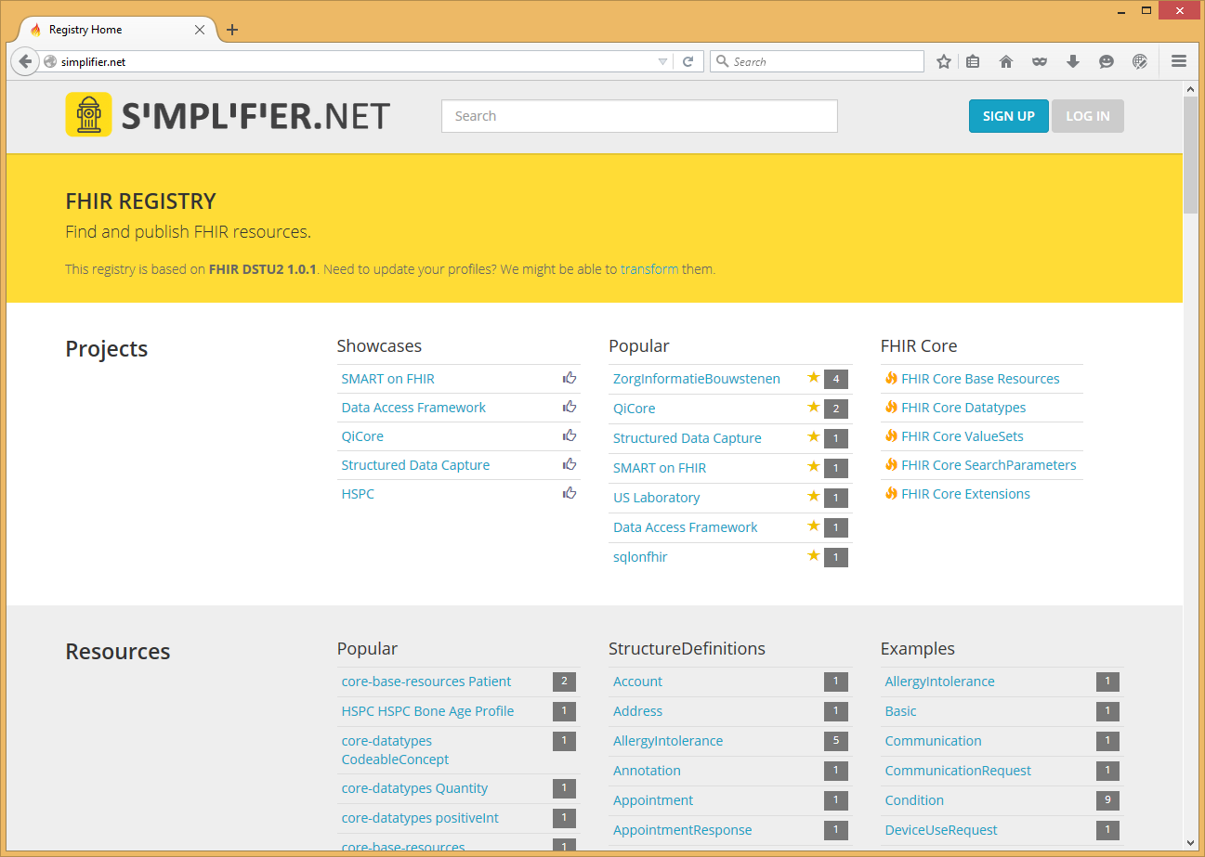
FHIR Registry
Notes:
Demo!

Slide 43


Questions?
http://hl7.org/fhir lmckenzie@gevityinc.com

